Slide 1
Digital Logic Design
Chapter 5
Combinational Logic with MSI and LSI

Slide 2
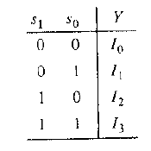
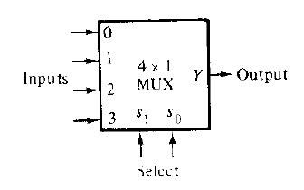
Multiplexer
A digital multiplexer is a combinational circuit that selects binary information from one of many input lines and directs it to a single output line.
The selection of a particular input line is controlled by a set of selection lines.
For n selection lines, there are 2^{n} input lines.

Slide 3
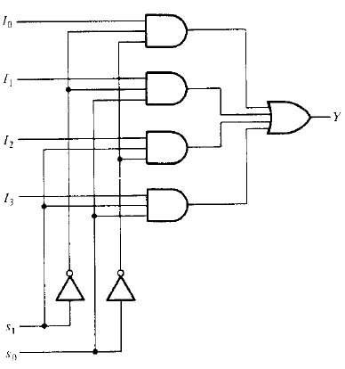
Multiplexer
Multiplexer is abbreviated as MUX.
Logic diagram of a 4-to-1 line multiplexer:

Slide 4
Multiplexer
Multiplexer can be constructed from a decoder.
2^{n} input lines are added to n-to-2^{n} decoder, one to each AND gate.
Finally the outputs of AND gates are applied to a single OR gate to make 1 output line.
The logic diagram is left for you as exercise.

Slide 5
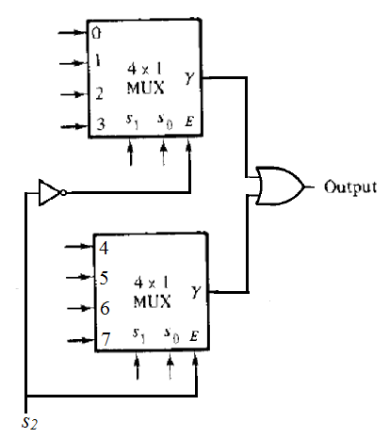

Multiplexer
Construct an 8$×$1 MUX using two 4$×$1 MUXs.

Slide 6
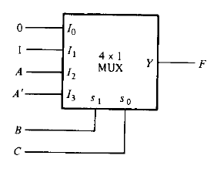
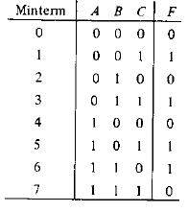
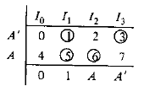
Boolean Function Implementation
If we have a Boolean function of n+1 variables, we take n of these variables and connect them to the selection lines of a multiplexer.
The remaining single variable of the function is used for the inputs of the multiplexer.
For example: F(A, B, C) = Ʃ(1, 3, 5, 6)

Slide 7
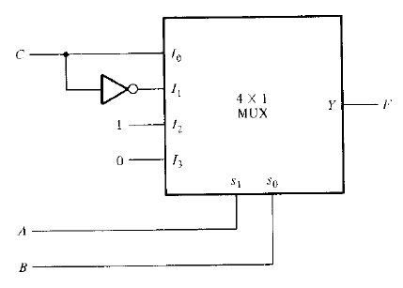
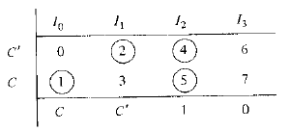
Boolean Function Implementation
For another example: F(A, B, C) = Ʃ(1, 2, 4, 5)

Slide 8
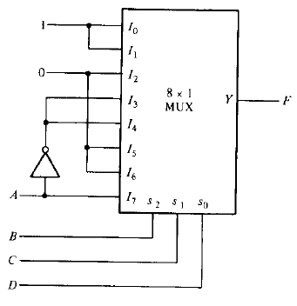
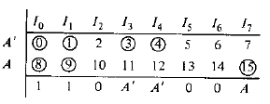
Boolean Function Implementation
Implement the function F(A, B, C, D) = Ʃ(0, 1, 3, 4, 8, 9, 15)

Slide 9
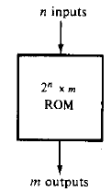

Read Only Memory (ROM)
A ROM is a device that includes both decoder and OR gates within a single package.
It consists of n input lines and m output lines.
Each bit combination of the input variables is called an address.
Each bit combination that comes out of the output lines is called a word.
For n variables, there are 2^{n} distinct addresses and for each address, there is a word. It is named as 2^{n}$×$m ROM.

Slide 10
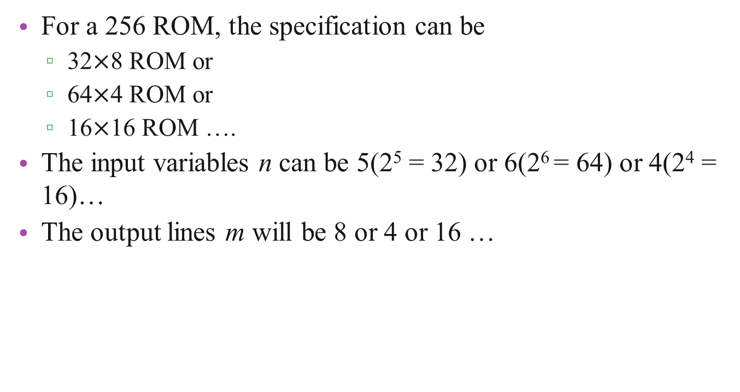
Read Only Memory (ROM)
For a 256 ROM, the specification can be
32$×$8 ROM or
64$×$4 ROM or
16$×$16 ROM ….
The input variables n can be 5(2⁵ = 32) or 6(2⁶ = 64) or 4(2⁴ = 16)…
The output lines m will be 8 or 4 or 16 …

Slide 11
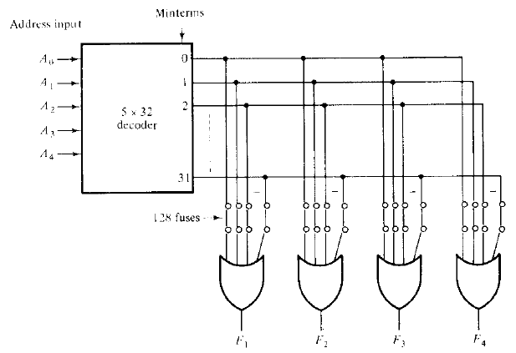
Read Only Memory (ROM)
ROM contains permanent binary information. It contains electronic fuses which are programmed by the designer.

Slide 12
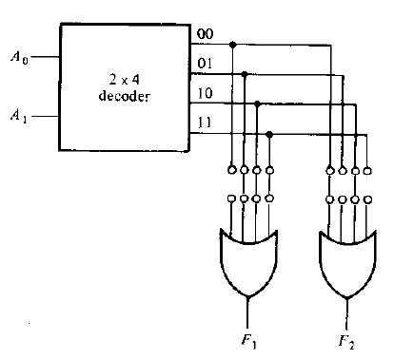
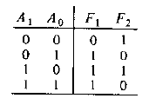

Combinational Logic Implementation
Implement the following functions with a ROM.
F₁(A₀, A₁) = Ʃ(1, 2, 3) and F₂(A₀, A₁) = Ʃ(0, 2)
Solution: As there are 2 inputs and 2 outputs, the size of ROM is 4$×$2. (For AND-OR gates)

Slide 13
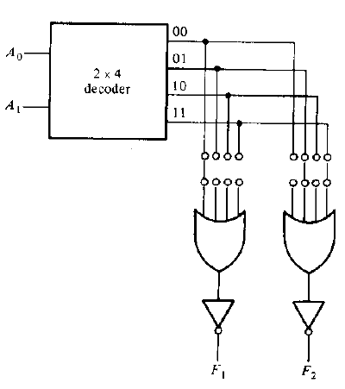

Combinational Logic Implementation
Implement the following functions with a ROM.
F₁(A₀, A₁) = Ʃ(1, 2, 3) and F₂(A₀, A₁) = Ʃ(0, 2)
Solution: As there are 2 inputs and 2 outputs, the size of ROM is 4$×$2. (For AND-OR-INVERT gates)

Slide 14
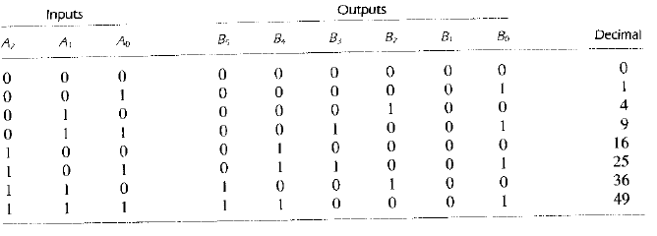
Combinational Logic Implementation
Design a combinational circuit using a ROM. The circuit accepts 3-bit number and generates an output binary number equal to the square of the input number.
Solution: First we need the truth table. But we must not be naive in designing the circuit.

Slide 15
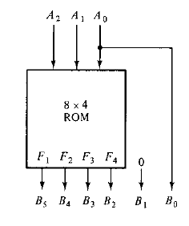
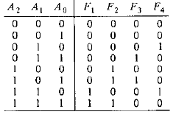
Combinational Logic Implementation
As it accepts 3-bit number, input variable n will be 3. So 2³ = 8.
The output lines can be 8, as we have 6 outputs. But that can be reduced to 4 technically.

Slide 16
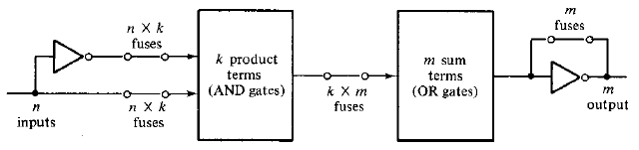
Programmable Logic Array (PLA)
A combinational circuit may have don’t care conditions which become address inputs that will never occur.
It is more economical to use a second type of LSI component called a programmable logic array (PLA).
It consists of n inputs, m outputs, k product terms and m sum terms.

Slide 17
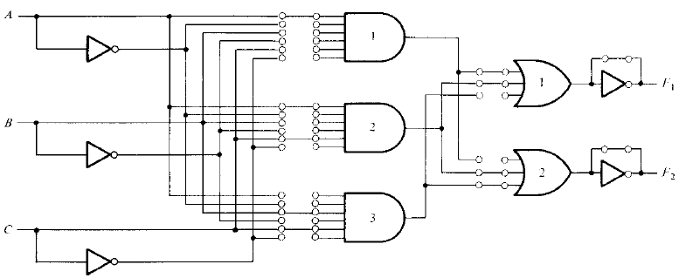
Programmable Logic Array (PLA)
PLA with three inputs, three product terms and two outputs implemented with combinational circuit is shown:

Slide 18
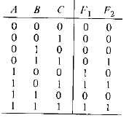
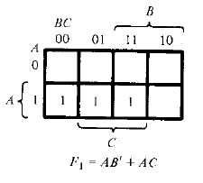
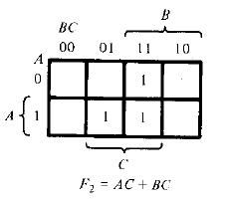
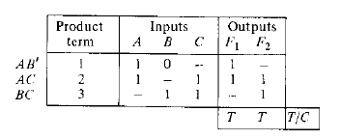
Programmable Logic Array (PLA)

Slide 19
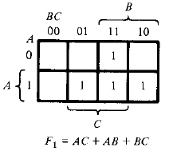
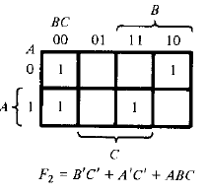

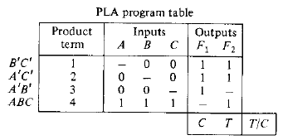
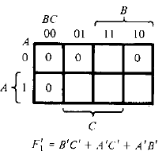
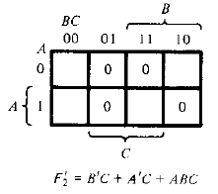
Programmable Logic Array (PLA)
Implement the functions with a PLA having three inputs, four product terms and two outputs.
F₁ = Ʃ(3, 5, 6, 7) and F₂ = Ʃ(0, 2, 4, 7)

